Slide 1
Chapter 6: Spatial Sampling Designs and Analysis
Anna Malesis

Slide 2
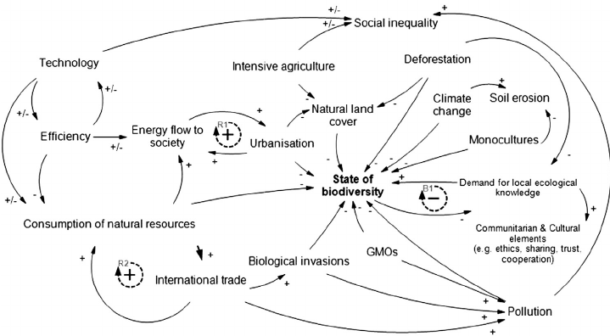
Scientific Method Challenges in Ecology
Multicausality: many ecological variables are impacted by many other variables simultaneously
Tapering Effects: there are many mechanisms with at least some small effect on ecological dynamics
Lack of Experimental Control: experiments are rarely possible, so ecologists must often identify dominant mechanisms from incomplete information or work with analogous systems
Notes:
Ecologists are faced with unique challenges in the scientific process. The first is multicausality—many ecological variables are impacted by many other variables at the same time. For example, this causal diagram shows how many different factors all impact biodiversity.
Next, are tapering effects. This refers to how there are many mechanisms that have at least some small effect on ecological dynamics, as opposed to other disciplines of science, where phenomena can often be explained by a few key mechanisms.
Finally, ecologists have to deal with a lack of experimental control—experiments are rarely possible, so ecologists have to work with incomplete information or in an analogous systems

Slide 3
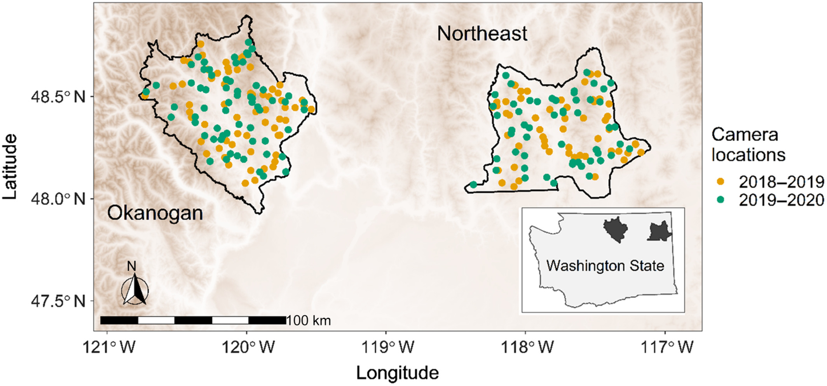
Ecological Monitoring
Issues in design and analysis:
Spatial integration: how to estimate a spatially integrated total from local measurements
Non-ignorable sampling designs: how to analyze data that arise non-experimentally or where data availability might be correlated with the variable of interest
Multi-stage sampling: how to analyze data with multiple levels of subsampling
Notes:
As a result of these issues, ecologists often focus on ecological monitoring. The chapter discusses three issues with ecological monitoring. First is spatial integration—how to estimate a spatially integrated total from local measurements. Next, under non-ignorable sampling designs, data may not arise experimentally or data availability might be correlated with the variable of interest. Finally, with multistage sampling, we must be able to analyze data with multiple levels of subsampling.
Multiple of these issues might be encountered with camera trapping, since data from each camera site will need to be integrated over the whole site, and factors that impact camera placement, such as trails, roads, or elevation, might also impact the presence of the focal species.

Slide 4
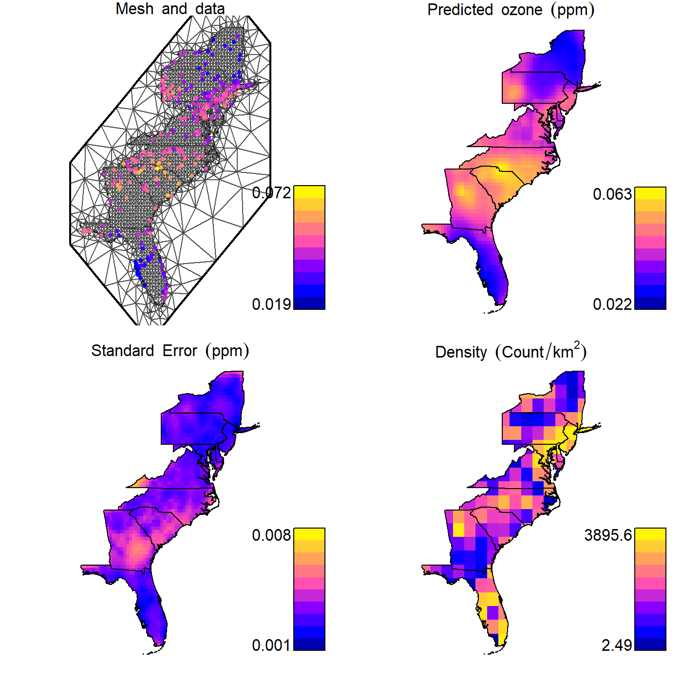
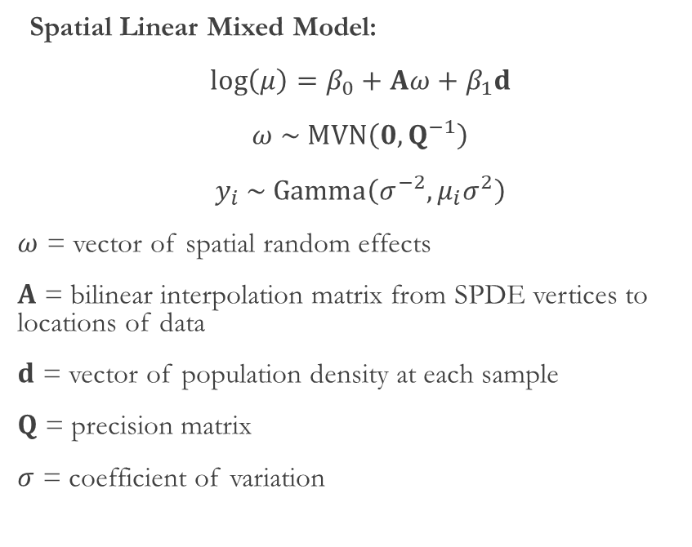
Spatial Integration
Spatial Linear Mixed Model:
$\log\left(μ\right)=β_{0}+Aω+β_{1}d$
$ω \sim MVN\left(0,Q^{−1}\right)$
$y_{i} \sim Gamma\left(σ^{−2},{μ_{i}σ}^{2}\right)$
$ω$ = vector of spatial random effects
$A$ = bilinear interpolation matrix from SPDE vertices to locations of data
$d$ = vector of population density at each sample
$Q$ = precision matrix
$σ$ = coefficient of variation
Notes:
First I will discuss spatial integration
This example uses a spatial linear mixed model to integrate ozone concentration across space using a vector of spatial random effects (omega) and the vector of population density at each sample (d). A is the matrix representing bilinear interpolation from the SPDE vertices to the locations of the data, Q is the precision matrix, and sigma is the coefficient of variation. This model can be used to predict ozone concentration at any location within the spatial domain where the covariate d (population density) is known

Slide 5
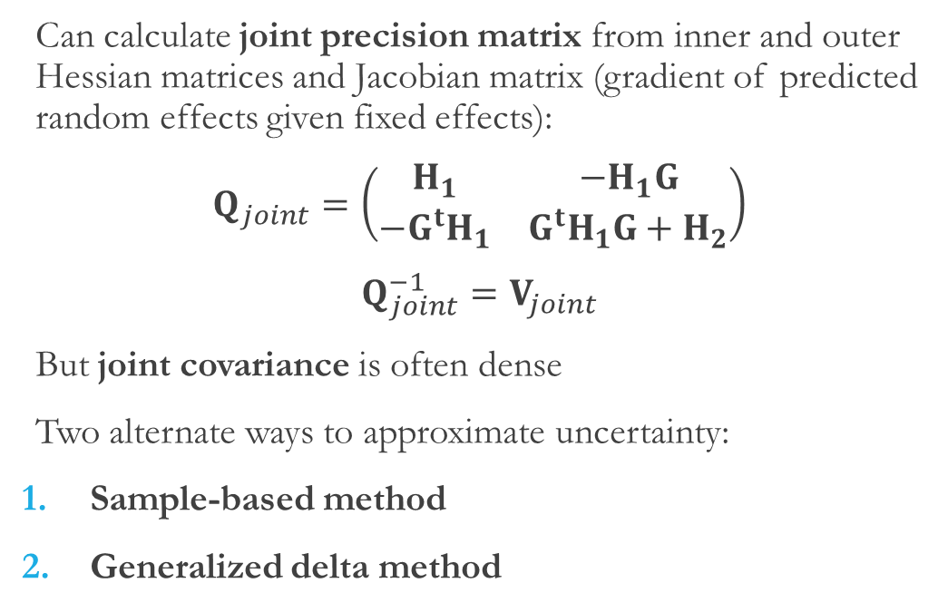
Estimating Uncertainty
Can calculate joint precision matrix from inner and outer Hessian matrices and Jacobian matrix (gradient of predicted random effects given fixed effects):
$Q_{joint}=\left(\begin{matrix}H_{1} & {−H}_{1}G \\ {−G}^{t}H_{1} & G^{t}H_{1}G+H_{2}\end{matrix}\right)$
$Q_{joint}^{−1}=V_{joint}$
But joint covariance is often dense
Two alternate ways to approximate uncertainty:
Sample-based method
Generalized delta method
Notes:
As seen in this panel of the map, we also need to estimate the uncertainty of our predictions. We can calculate the joint precision matrix (q joint) from the inner and outer Hessian matrices and the Jacobian matrix, which contains the gradient of predicted random effects given fixed effects).
Q joint is normally sparse, but inverting it to calculate the joint covariance (v joint) can result in a dense matrix, which can be computationally unfeasible.
Instead, there are two alternate ways to approximate uncertainty—the sample-based method and the generalized delta method

Slide 6
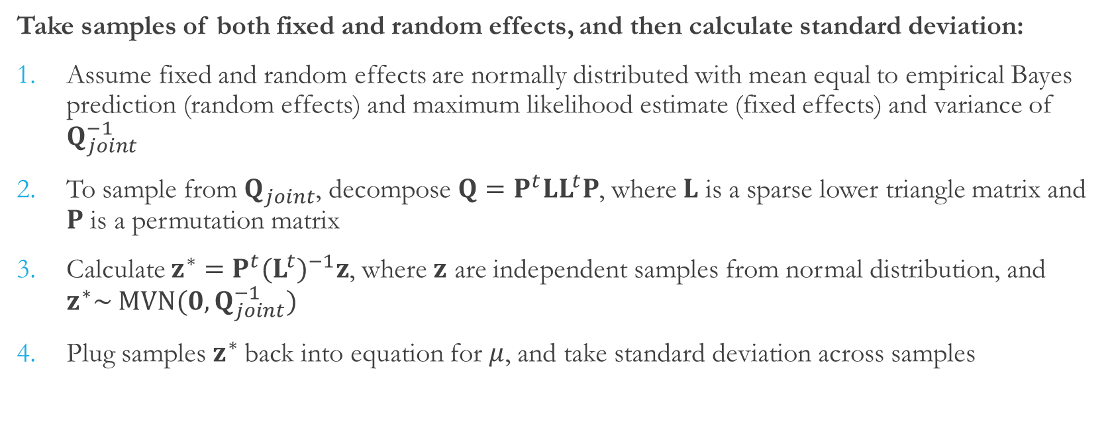
Sample-Based Method
Take samples of both fixed and random effects, and then calculate standard deviation:
Assume fixed and random effects are normally distributed with mean equal to empirical Bayes prediction (random effects) and maximum likelihood estimate (fixed effects) and variance of $Q_{joint}^{−1}$
To sample from $Q_{joint}$, decompose $Q=P^{t}LL^{t}P$, where $L$ is a sparse lower triangle matrix and $P$ is a permutation matrix
Calculate $z^{∗}=P^{t}(L^{t})^{−1}z$, where $z$ are independent samples from normal distribution, and $z^{∗}\sim MVN(0,Q_{joint}^{−1})$
Plug samples $z^{∗}$back into equation for $μ$, and take standard deviation across samples
Notes:
The sample-based method involves taking samples of both fixed and random effects, and then calculating the standard deviation across samples. This method assumes that fixed and random effects are normally distributed with means equal to their empirical bayes predictions and maximum likelihood estimates, and with variances of the inverse of the joint precision matrix. To sample from the joint precision matrix, we decompose it into a sparse lower triangle matrix L and permutation matrix P. With L and P, we can now calculate Z*, where z are independent samples from a normal distribution. The distribution of Z* approximates draws from a multivariate normal distribution with variance equal to the inverse of q joint. Then plug these samples z* back into the equation for mu, and take the standard deviation across samples to approximate the predictive standard error

Slide 7
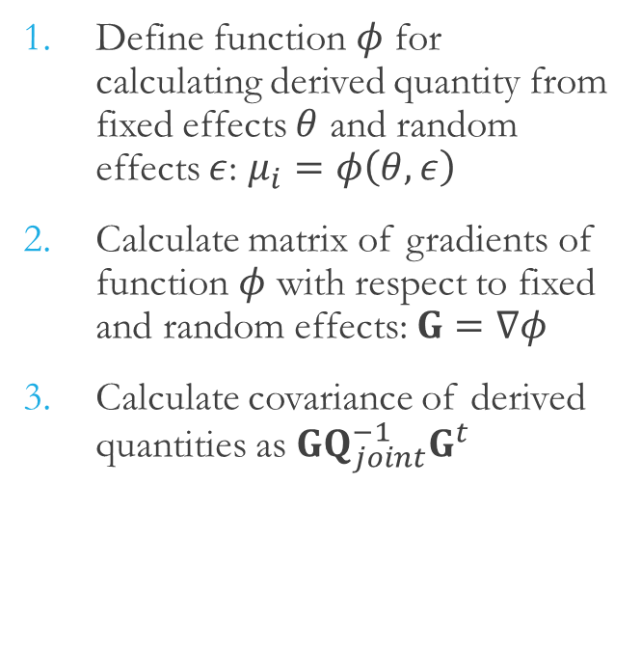
Generalized Delta Method
Define function $φ$ for calculating derived quantity from fixed effects $θ$ and random effects $ε$: $μ_{i}=φ\left(θ,ε\right)$
Calculate matrix of gradients of function $φ$ with respect to fixed and random effects: $G=∇φ$
Calculate covariance of derived quantities as $GQ_{joint}^{−1}G^{t}$
Notes on each method
Generalized delta method can be computationally expensive—calculating gradients for each derived quantity
Sample-based method introduces sampling error by calculating uncertainty from a specified number of samples
Choice depends on context (number of random effects vs. need for precision)
Notes:
For the generalized delta method, we define a function phi for calculating a derived quantity from fixed effects, calculate the matrix of function phi with resect to fixed and random effects, and then calculate the covariance of derived quantities
This method can be computationally expensive, since it requires calculating gradients for each derived quantity. However, the sample-based method introduces sampling error by calculating uncertainty from a specified number of samples. The choice between these two depends on context—such as the number of random effects versus the need for precision

Slide 8
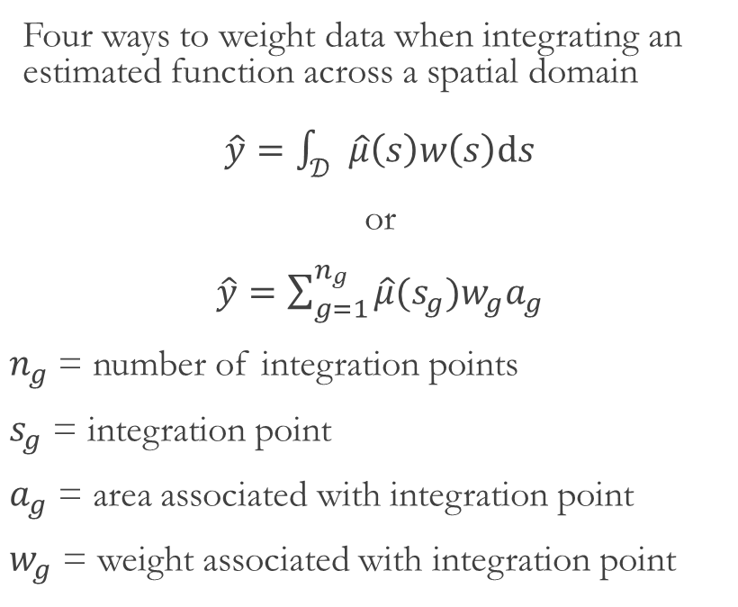
Expansion Weights
Four ways to weight data when integrating an estimated function across a spatial domain
$\hat{y}=\int_{𝒟}{\hat{μ}\left(s\right)w\left(s\right)ds}$
or
$\hat{y}=\sum_{g=1}^{n_{g}}{\hat{μ}(s_{g})w_{g}a_{g}}$
$n_{g}$ = number of integration points
$s_{g}$ = integration point
$a_{g}$ = area associated with integration point
$w_{g}$ = weight associated with integration point
Sample-weighted total: same number of integration points as samples, and equal area and weight for each integration point
Area-weighted average: equal weight to all points, but different areas (points near an irregularly shaped boundary may represent a smaller area)
Covariate-weighted average: weight based on a known quantity
Multivariate-weighted average: covariate weighting, but using another modeled variable instead of a fixed covariate
Notes:
Next I will discuss expansion weights.
Ecologists often have to integrate an estimated function across a spatial domain. This process is described by these two equations, one in integral form and on in summation form. In summation for, Ng represents the number of integration points, sg represents each integration point, ag is the area associated with the integration point, and wg is the weight associated with that point. Here are four methods for defining the area and weight for each integration point.
First, under sample-weighted total, there are the same number of integration points as samples, with an equal area and weight for this point.
The area-weighted average method assigns equal weight to all points, but different areas. For example, points near an irregularly shaped boundary may represent a smaller area.
The covariate weighted average method weights each integration point based on a known quantity—for example, predicted ozone concentration could be weighted by population density to calculate exposure
Finally, the multivariate-weighted average method is like the covariate weighting, but using another modeled variable instead of a fixed covariate—ex: calculate average body size by weighing the prediction of body size at each integration point with the predicted proportion of abundance at that point

Slide 9
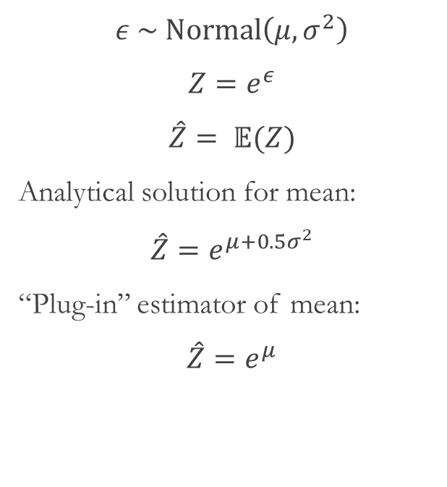
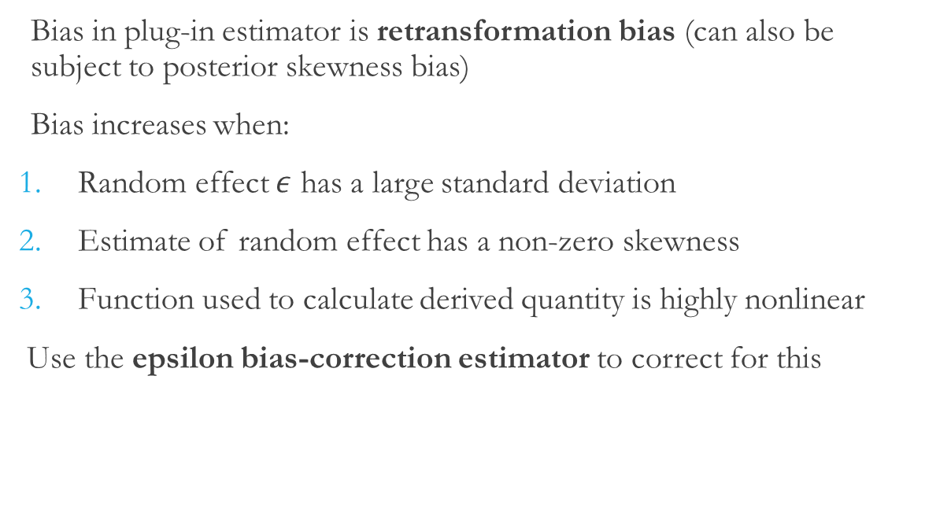
Retransformation Bias
$ε \sim Normal\left(μ, σ^{2}\right)$
$Z=e^{ε}$
$\hat{Z}= 𝔼(Z)$
Analytical solution for mean:
$\hat{Z}=e^{μ+0.5σ^{2}}$
“Plug-in” estimator of mean:
$\hat{Z}=e^{μ}$
Bias in plug-in estimator is retransformation bias (can also be subject to posterior skewness bias)
Bias increases when:
Random effect $ε$ has a large standard deviation
Estimate of random effect has a non-zero skewness
Function used to calculate derived quantity is highly nonlinear
Use the epsilon bias-correction estimator to correct for this
Notes:
The next issue is retransformation bias.
If we have normally distributed random variable epsilon but want to estimate variable Z, we have to use a nonlinear transformation—in this case exponentiation. Z follows a lognormal distribution, but the analytical solution for the mean of this distribution is different than the simple “plug in” estimator.
This results in retransformation bias. The plug in estimator can also be subject to posterior skewness bias if random effects are not normally distributed.
This bias increases when the random effect epsilon has a large standard deviation, has nonzero skewness, or the function used to calculate the derived quantity is highly nonlinear. We can use the epsilon bias-correction estimator to correct for this

Slide 10
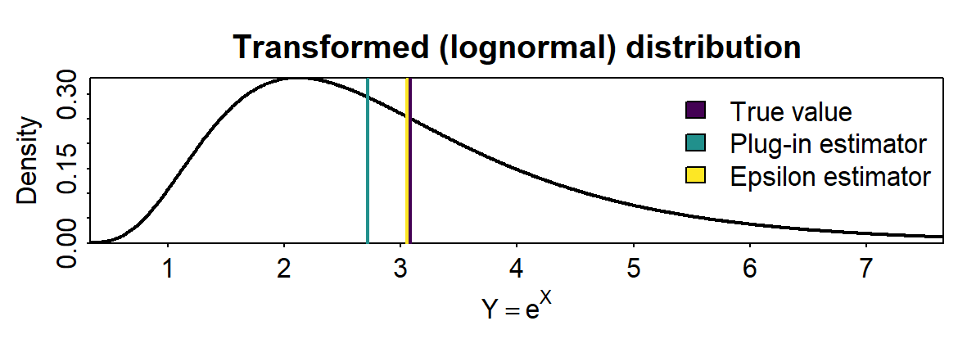
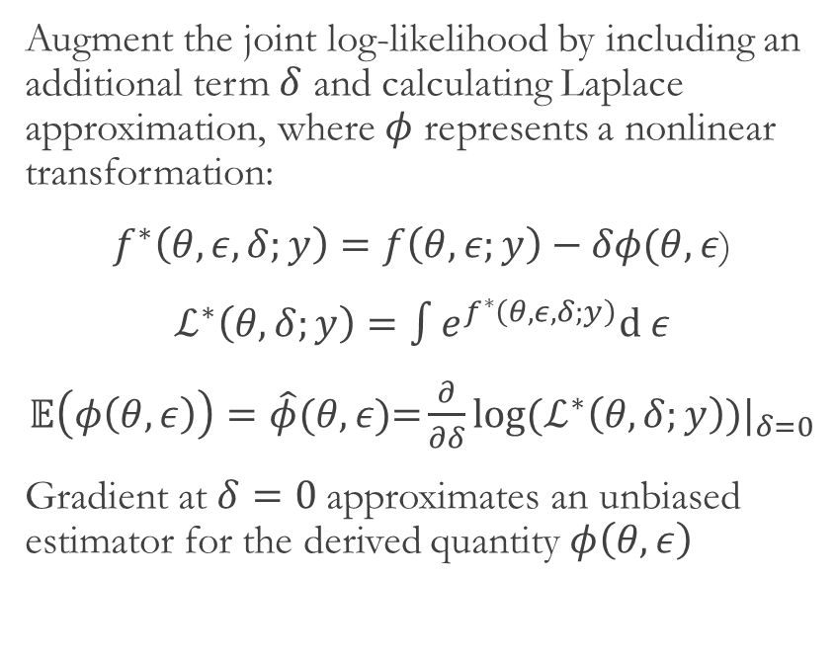
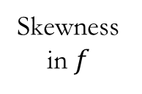
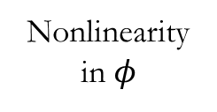
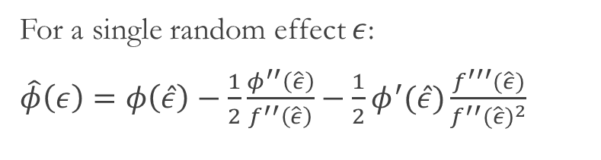
Epsilon Bias-Correction Estimator
Augment the joint log-likelihood by including an additional term $δ$ and calculating Laplace approximation, where $φ$ represents a nonlinear transformation:
$f^{∗}\left(θ,ε,δ;y\right)=f\left(θ,ε;y\right)−δφ(θ,ε$)
$ℒ^{∗}\left(θ,δ;y\right)=\int{e^{f^{∗}\left(θ,ε,δ;y\right)}d}$ $ε$
$𝔼\left(φ\left(θ,ε\right)\right)=\hat{φ}(θ,ε\text{)=}\frac{∂}{∂δ}{log⁡(ℒ^{∗}\left(θ,δ;y\right))|}_{δ=0}$
Gradient at $δ=0$approximates an unbiased estimator for the derived quantity $φ\left(θ,ε\right)$
For a single random effect $ε$:
$\hat{φ}\left(ε\right)=φ\left(\hat{ε}\right)−\frac{1}{2}\frac{φ^{′′}\left(\hat{ε}\right)}{f^{′′}\left(\hat{ε}\right)}−\frac{1}{2}φ^{′}(\hat{ε})\frac{f^{′′′}(\hat{ε})}{f^{′′}{(\hat{ε})}^{2}}$
Nonlinearity in $φ$
Skewness in $f$
Plug-in
Notes:
The epsilon bias-correction estimator is an augmented version of the Laplace approximation that includes an additional term delta. Here, phi represents the nonlinear transformation. The gradient in the third line at delta = 0 approximates an unbiased estimator for the derived quantity. As shown in the graph the epsilon estimator is much closer to the true value than the plug-in estimator
When using the estimator for a single random effect, it can be decomposed into three terms: the plugin estimator, a term that corrects for the nonlinearity in phi, and a term that corrects for skewness
However, the epsilon bias-correction estimator can break the sparsity of the inner Hessian and increase computation time, so it should only be used when high accuracy bias correction is important. Otherwise, sampling from the multivariate normal approximation of the joint likelihood F as described in the sample-based method is sufficient– it will correct for the nonlinearity in phi, but not skewness.

Slide 11
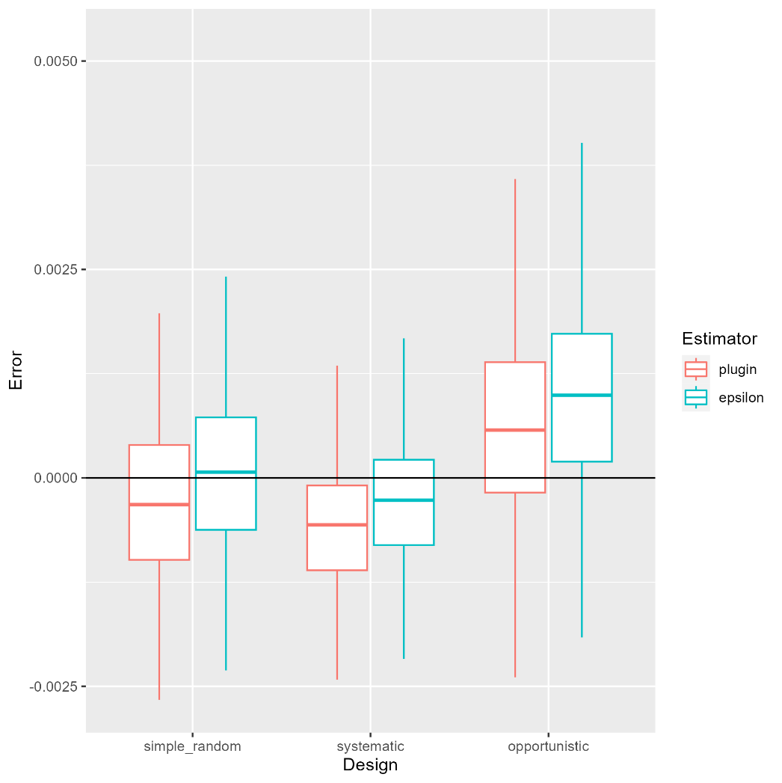
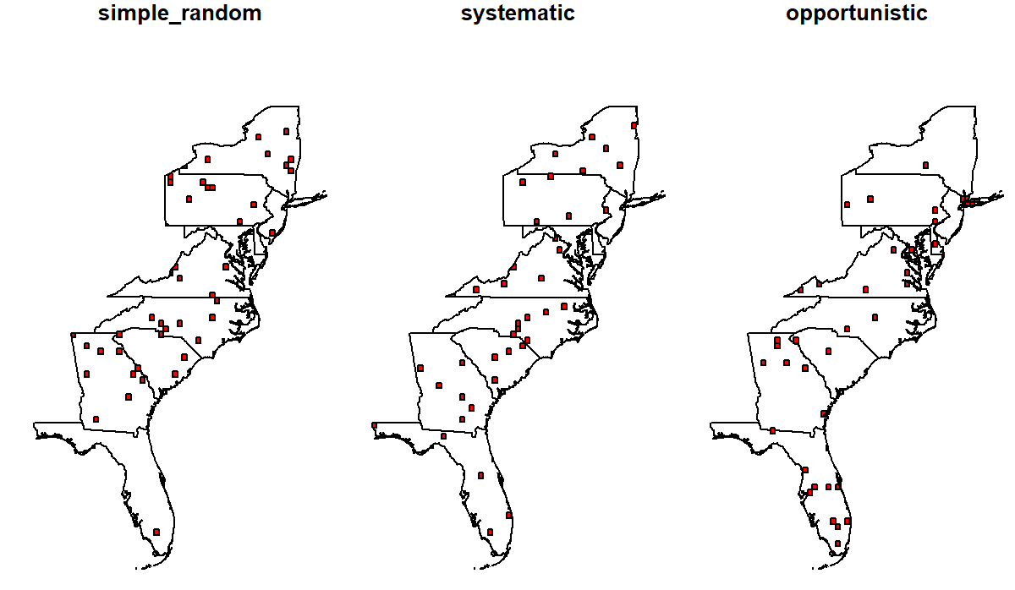
Spatial Sampling Designs
Can include probability sampling, or not:
Simple random sampling
Systematic sampling
Opportunistic sampling
Notes:
Moving on, ecologists use a variety of different sampling designs, some of which are probability sampling designs and some of which are not. Simple random samples or stratified random samples are probability designs, where each site has some probability of being chosen. Systematic or cluster samples may or may not include involve probability sampling, while opportunistic sampling generally does not. The three designs that the chapters focused on were simple random sampling, systematic sampling, and opportunistic sampling. Would anyone like to define or provide examples for these?
Simple - all sampling units have equal probability of selection
Systematic – sampling at some predefined frequency based on a defined order. The goal is to ensure samples are evenly spread across space. In the example, sites are selected based on a numbered sequence of grid cells. This forms some patterns where the width of the state is similar to the sampling interval.
Opportunistic – Data arises from some non-random process that can’t be controlled. In the example, ozone measurements are taken from cells with the highest population sizes.
Comparing the results from these different designs, the simple random sample is the least biased, the systematic design has the smallest variance because of the more even spatial distribution of samples, and the opportunistic design overestimates ozone concentration.

Slide 12
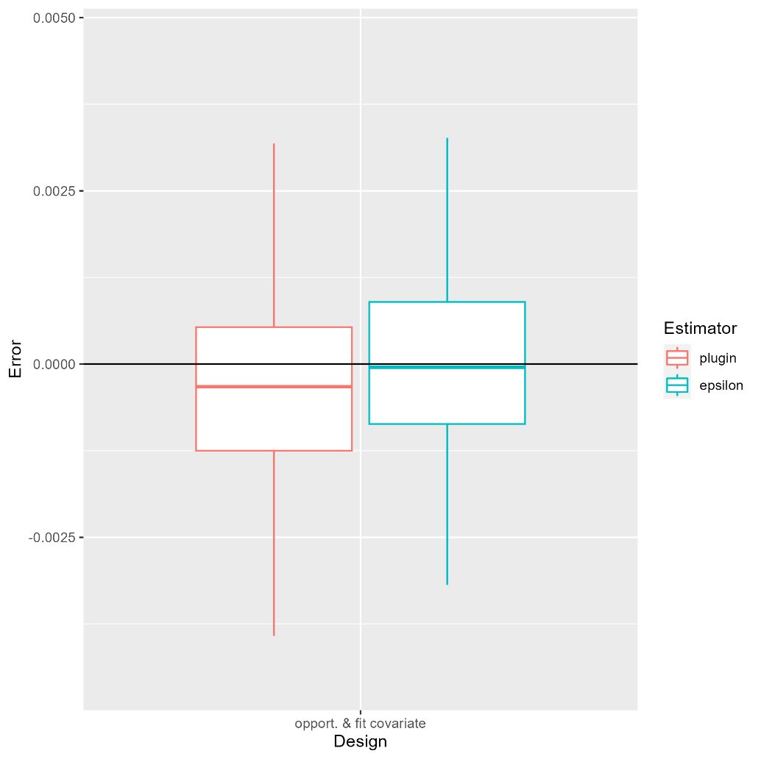
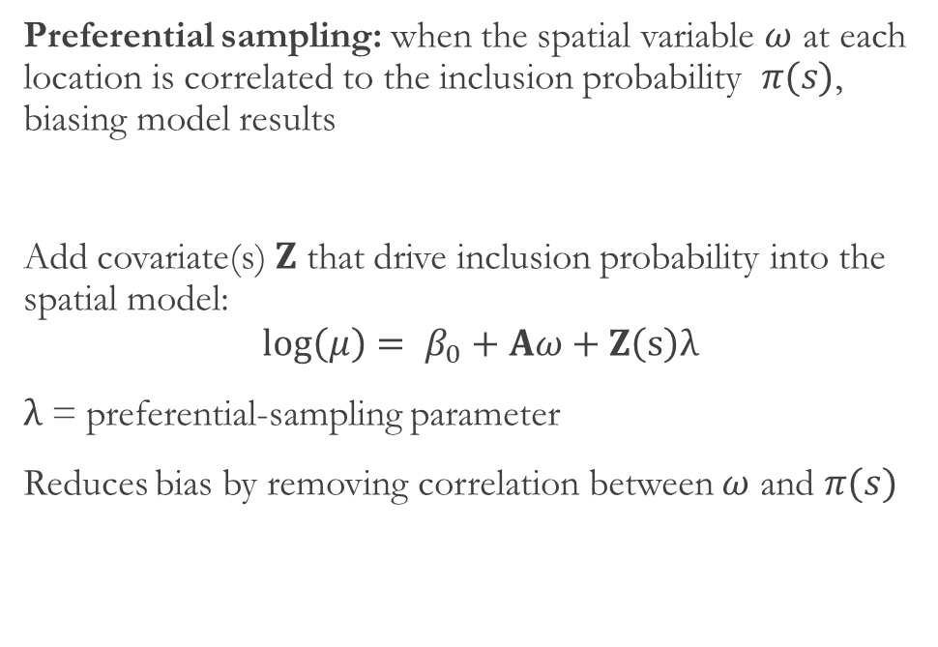
Preferential Sampling
Preferential sampling: when the spatial variable $ω$ at each location is correlated to the inclusion probability $π(s)$, biasing model results
Add covariate(s) $Z$ that drive inclusion probability into the spatial model:
$$\log\left(μ\right)= β_{0}+Aω+Z\left(s\right)λ$$
$λ$ = preferential-sampling parameter
Reduces bias by removing correlation between $ω$ and $π(s)$
Notes:
This occurs because the most densely populated areas have the highest ozone concentration.
This is an example of preferential sampling--when the spatial variable at each location is correlated to the inclusion probability, which biases model results
It is best to avoid preferential sampling by ensuring that the inclusion probability is independent from the target variable, but this is not always possible. In these cases, you can include the variable (z) that drives inclusion probability into the model with preferential-sampling parameter lambda. This removes the correlation between the spatial variable and inclusion probability, reducing the bias of the estimate.
The graph shoes that the error from the opportunistic design with this covariate is much lower than on the previous slide.

Slide 13
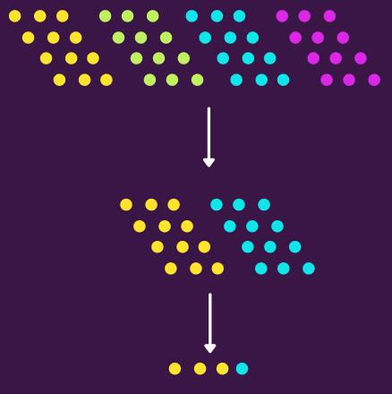
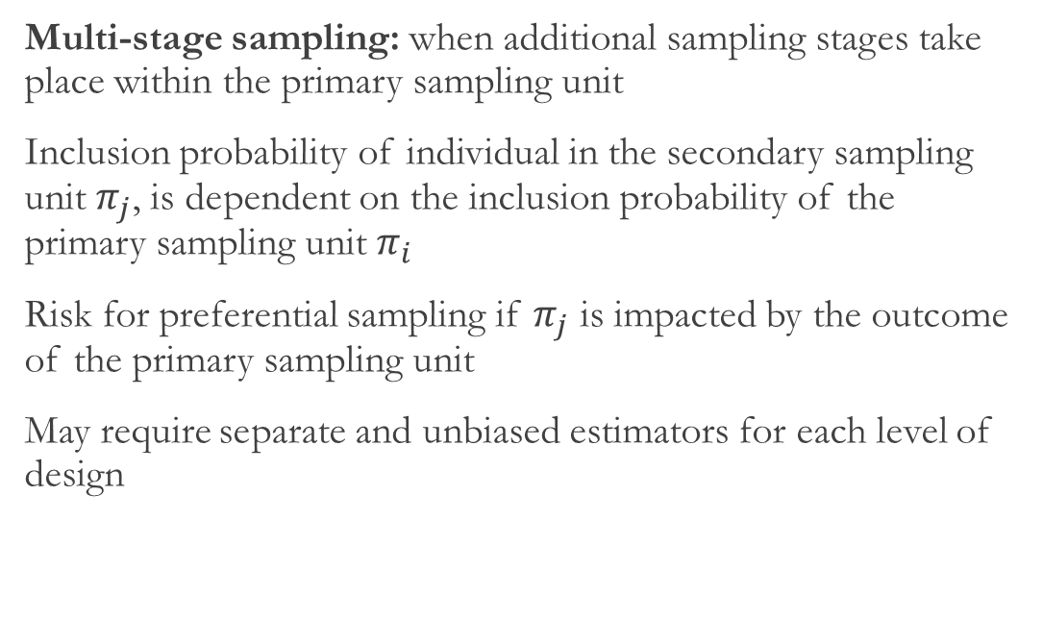
Multi-Stage Sampling
Multi-stage sampling: when additional sampling stages take place within the primary sampling unit
Inclusion probability of individual in the secondary sampling unit $π_{j}$, is dependent on the inclusion probability of the primary sampling unit $π_{i}$
Risk for preferential sampling if $π_{j}$ is impacted by the outcome of the primary sampling unit
May require separate and unbiased estimators for each level of design
Notes:
Multistage sampling is when additional sampling stages take place within the primary sampling unit. Ex?
The example from the chapter describes how fisheries scientists might use established protocols to sample fish abundance over large areas, and then use a subsample of captured individuals to measures age, body size, condition, etc.
The inclusion probability of individual in the secondary sampling unit $π_{j}$, is dependent on the inclusion probability of the primary sampling unit $π_{i}$. There is a risk for preferential sampling if $π_{j}$ is impacted by the outcome of the primary sampling unit—such as if an abnormally large number of fish is captured in the primary sample, a smaller proportion of those fish will be likely be included in the secondary sample for measuring. Addressing this may require separate and unbiased estimators for each level of design.

Slide 14
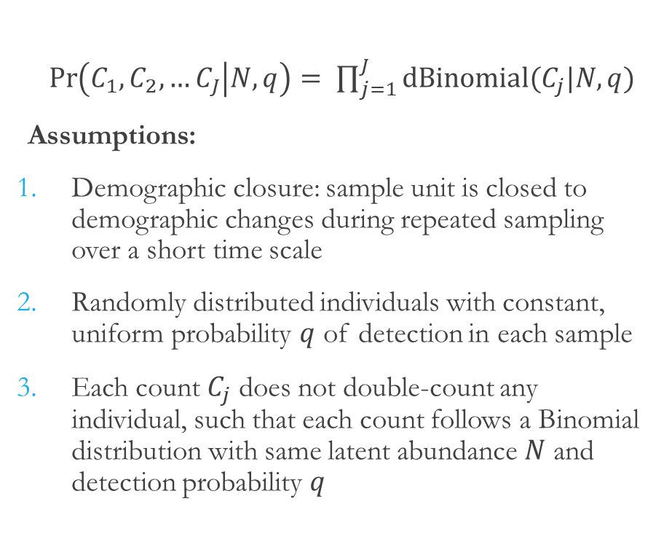
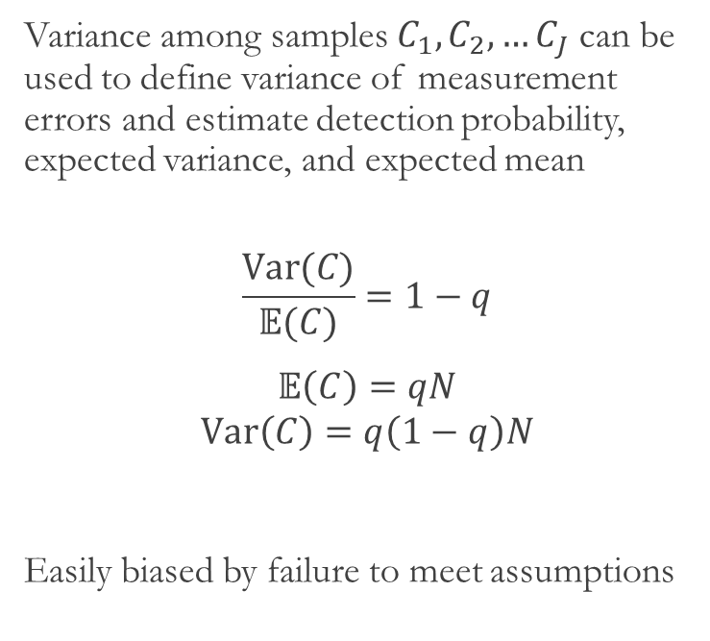
N-Mixture Models
$\operatorname{Pr}\left(C_{1},C_{2},…C_{J} | N,q\right)= \prod_{j=1}^{J}{dBinomial(C_{j}|N,q)}$
Assumptions:
Demographic closure: sample unit is closed to demographic changes during repeated sampling over a short time scale
Randomly distributed individuals with constant, uniform probability $q$ of detection in each sample
Each count $C_{j}$ does not double-count any individual, such that each count follows a Binomial distribution with same latent abundance $N$ and detection probability $q$
Variance among samples $C_{1},C_{2},…C_{J}$ can be used to define variance of measurement errors and estimate detection probability, expected variance, and expected mean
$$\frac{Var(C)}{𝔼(C)}=1−q$$
$𝔼\left(C\right)=qN$
$$Var\left(C\right)=q\left(1−q\right)N$$
Easily biased by failure to meet assumptions
Notes:
When a sample unit is repeatedly sampled over a short timescale, you can use a N-mixture model, if the following assumptions are met:
The first is demographic closure: sample unit is closed to demographic changes during repeated sampling over a short time scale
Second, individuals are randomly distributed with a constant, uniform detection probability q in each sample.
Third, each count Cj does not count the same individual multiple times, such that each count follows a Binomial distribution with same latent abundance $N$ and detection probability $q$
Under these assumptions, the variance among samples can be used to define the variance of measurement errors and estimate detection probability, expected variance, and expected mean
However, estimates of q can be easily biased by failure to meet assumptions

Slide 15
Chapter Summary
Inference about spatial patterns involves spatial integration by identifying spatial integration points, predicting variables at those locations, and aggregating across integration points. This can be weighted in multiple ways.
Uncertainty in derived quantities can be approximated from the joint precision matrix using the sample-based or generalized delta method.
Estimating quantities resulting from both random and fixed effects from a simple “plug-in” estimator can result in retransformation bias, which can be corrected with the epsilon estimator.
Different sampling designs, which may or may not include probability sampling, have trade offs between sampling efficiency and potential bias.
Preferential sampling is a form of bias that occurs when inclusion probabilities are correlated with the target variable. It canbe mitigated by adding covariates that explain sampling intensity into the spatial model.
Notes:
For a chapter summary:
Inference about spatial patterns involves spatial integration by identifying spatial integration points, predicting variables at those locations, and aggregating across integration points. This can be weighted in multiple ways.
Uncertainty in derived quantities can be approximated from the joint precision matrix using the sample-based or generalized delta method.
Estimating quantities resulting from both random and fixed effects from a simple “plug-in” estimator can result in retransformation bias, which can be corrected with the epsilon estimator.
Different sampling designs, which may or may not include probability sampling, have trade offs between sampling efficiency and potential bias.
Preferential sampling is a form of bias that occurs when inclusion probabilities are correlated with the target variable. It can be mitigated by adding covariates that explain sampling intensity into the spatial model.

